Slide 1
Net Zero Carbon: Working Together to tackle Climate Change
Annual Parish Liaison Event
4th July 2022
Notes:
Average Annual global temperatures 1850 – 2018
Source: University of Reading, Prof Ed Hawkins, #ShowYourStripes

Slide 2
Agenda
19:45 Update on Net Zero Leicestershire: Strategy, Action Plan and Consultation
20:00 Workshop: Barriers and Solutions to Climate Action
20:20 Feedback and Next Steps
20:30 Close

Slide 3
Introduction
The County Council declared a climate emergency in 2019
We plan to achieve net zero carbon for our own operations by 2030, having already reduced emissions by 74% since 2008-09
We also committed to working with others to achieve net zero carbon in Leicestershire by 2045
To facilitate this we commissioned research into the county’s carbon baseline emissions, pathways to net zero and have developed the Leicestershire 2045 Net Zero Strategy and Action Plan
We are holding a 12 week consultation open from May to July 2022, where we will seek feedback from stakeholders and residents before finalising the strategy and plan for September 2022
Consultation survey is available at www.leicestershire.gov.uk/netzeroconsultation

Slide 4
Net Zero – Why and How?
The Paris Agreement seeks to limit global warming to well below 2°C, preferably to 1.5°C, compared to the pre-industrial levels.
Warming of even half a degree beyond the Paris Agreement will significantly worsen the risks of drought, floods, extreme heat and poverty for hundreds of millions of people.
With current commitments and ambition on emissions reductions, global temperature rise could reach between approximately 2°C and 4°C by the end of this century, or potentially even higher. We are already at 1.2°C of warming.
The pathway to net zero is challenging but possible; change is required at pace and scale. Although some solutions are not yet feasible or viable beyond demonstration we need to take more steps urgently.
The Council cannot achieve net zero carbon across Leicestershire by 2045 working alone - collaboration and engagement will play a key role in success.
Investment will be required from all sectors but there are benefits to be accrued for the economy, society and the environment if the transition is just and fair.

Slide 5
Leicestershire Net Zero Carbon 2045 Roadmap Research

Slide 6
2045 Net Zero Roadmap
Technical evidence base for Leicestershire action
Inform the Council’s Strategy and Action Plan
Assess the options for achieving net zero
Identify key partners, support partner engagement and actions
Understand what can be gained – co-benefits of transition e.g. health
Explore strengths and gaps in policy and resources
High level recommendations for action
A springboard to wider commitments and action from partners

Slide 7
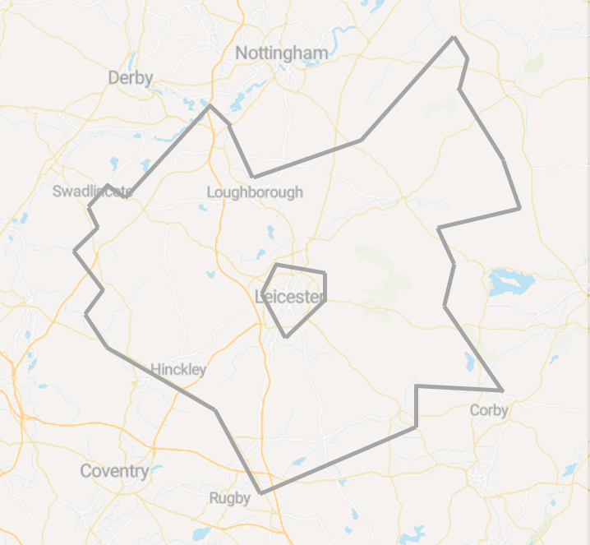
Leicestershire Emissions Sources
Territorial Emissions
Energy (electricity/gas/other) consumed within the geographical boundaries of Leicestershire
Consumption Emissions
Energy consumed outside Leicestershire, to provide goods and services for use within the county
Embodied carbon of food and drink
Electricity/gas/other use in Leicestershire
Agriculture in Leicestershire
Embodied carbon of construction and demolition
Industrial gas/electricity/other use in Leicestershire
Flights taken by Leicestershire residents/businesses
LULUCF
Water/waste consumed by business and residents in Leicestershire
Electricity generation inside Leicestershire
(renewables)
Road transport inside Leicestershire
F-gases
Carbon sequestration of local ecology
Territorial (BEIS sub-national)
Territorial (other sources)
Consumption
Carbon associated with services and goods

Slide 8
Leicestershire Baseline Emissions
The baseline of this study includes a wider scope of emissions categories than the BEIS data because the BEIS data does not include all categories identified as significant for Leicestershire through stakeholder engagement.
The baseline of this study includes:
BEIS baseline territorial emissions
Additional territorial emissions
Consumption emissions
Scoped consumption emissions:
3,489 ktCO₂e
Scoped territorial emissions:
5,021 ktCO₂e
Territorial (BEIS or DfT)
Territorial (other sources)
Consumption

Slide 9
Leicestershire Net Zero Pathways
Current Policy Pathway
Council-Influenced
Balanced
Tailwinds
Description
To illustrate emission reductions that might be achieved with existing policy commitments in Leicestershire
To illustrate what the council can achieve, and outline the collective action required to achieve net zero
To illustrate what Leicestershire could achieve following CCC and UK Government decarbonisation timeframes
To illustrate what Leicestershire could achieve through widespread, fast-paced change
Ambition
Low
High (only in council-influenced areas)
High
Very high
Key interventions
Very low level of retrofit
Electrification of cars and LGVs following national phase out of diesel/petrol
Increase is vehicle mileage
Increase in waste and water demand
65% of LCC-collected waste recycled
Retrofit of council-influenced buildings (2% of total)
2/3 buses switched to electric/hydrogen
PV installation on 25% of social housing and 40% of public buildings
Widespread retrofit of buildings
Full EV roll out and decrease in vehicle mileage
Industry heat source switched to electric/hydrogen
High PV installation
Near-total retrofit of buildings
Full EV roll out and decrease in vehicle mileage
Industry heat source switched to electric/hydrogen
Very high PV installation
Total reduction in embodied carbon of new builds

Slide 10
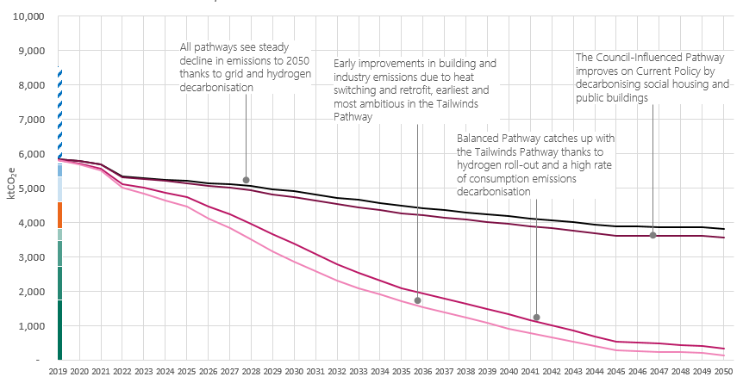
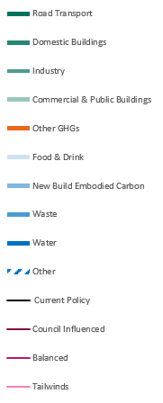
Leicestershire Net Zero Pathways

Slide 11
Net Zero Pathways and the Paris Agreement
Comparing Leicestershire’s Net Zero Pathways with a Paris Agreement-compliant pathway highlights the impact of cumulative emissions and the importance of acting now.
Every tonne of carbon emitted contributes to global warming and catastrophic climate change.
At current emission levels, budget will be used up before the end of the decade
6,000
5,000
4,000
3,000
2,000
1,000
-
Under Current Policy, 84,282 ktCO₂e will be emitted between 2019-2045, 224% more than the Paris Compliant budget allows
Under a Tailwinds Pathway, 47,802 ktCO₂e will be emitted between 2019-2045, 83% more than the Paris Compliant budget allows
Emissions over budget in the Net Zero Pathways
A Paris Compliant budget allows 26,070 ktCO₂e to be emitted between 2019-2045

Slide 12
2045 Roadmap Key Findings
The net zero 2045 target for Leicestershire cannot be delivered by the Council working alone.
The pathway to net zero is challenging but feasible, with a distinct need to act now.
Investment will be required from all sectors.
Net zero should be progressed within the context of other environmental objectives.
Carbon capture and storage should be built into plans but not relied upon.

Slide 13
Leicestershire’s Net Zero Strategy and Action Plan

Slide 14
Development of the Strategy and Action Plan
Informed by the evidence developed in the Roadmap study and climate science.
Built on best practice from other local authorities, following guidance and climate action plan checklists.
Officers from across the council have been engaged in its development.
The Action Plan will be reviewed annually and refreshed through an iterative process to keep up to date with policy and technology changes.
Quantification of costs and benefits and more detailed prioritisation is an aspiration for future iterations of the Action Plan.
The consultation offers an opportunity to add to the Strategy and Action Plan, identify synergies with other organisations’ plans and to engage and inspire the public.

Slide 15
Our Vision and Goals
“In 2045 Leicestershire has ended its contribution to global heating and has adapted to climate change. The just transition to net zero carbon emissions has improved the local environment for people and nature, increased prosperity and supported resilient communities.”
As a key place leader the County Council will:
Achieve net zero carbon emissions for the council’s operations by 2030
Enable carbon reduction across the county by delivering and facilitating the required infrastructure
Inspire partners and the public to develop a joined-up approach that delivers net zero carbon emissions across Leicestershire by 2045

Slide 16
Approach to Net Zero
Eliminate
Reduce
Substitute
Compensate & Neutralise
Stopping emissions being produced by doing things differently
Using energy more efficiently
Using renewable energy and low carbon replacements
Support carbon reduction elsewhere and permanently remove carbon from the atmosphere
Emissions included in the scope of the target:
Domestic, commercial, industrial and public building emissions
Road and rail transport
Household waste management
Other greenhouse gases (in addition to carbon dioxide)
Land use, land use changes and forestry
5 MtCO₂e
Notes:
Principles: Education & information, Fairness, Freedom & choice, Co-benefits, Nature

Slide 17
Cross Cutting Actions
Leadership: the council will demonstrate leadership by achieving net zero carbon emissions from its operations by 2030 and share knowledge and experience to promote best practice.
Collaboration: a team effort, driven by encouraging our residents and businesses to help shape a greener future for the county, and for future generations
Research & Innovation: working with others, the council will seek to fill gaps in knowledge to provide a robust evidence base for decisions and actions.
Informing, engaging & involving: supporting informed choices for sustainable lifestyles and practices through regular communications and campaigns.
Finance: the council will prioritise initiatives with multiple benefits and income generation, maximise grant support to Leicestershire, seek to unlock investment from private sources and attract green business to the county.

Slide 18
Carbon Reduction Themes
Each theme has an overall aim and objectives, accompanied with information on the opportunities and benefits of the net zero transition.
The themes and overall aims are: -
Decarbonised transport: Deliver sustainable, affordable transport choices for all that minimise carbon emissions
Net Zero Infrastructure: Reduce demand for energy, support the switch to low carbon energy and heat, increase renewable energy generation and the sustainable use of natural resources
Green Economy: Grow the County’s low carbon economy and increase demand for low carbon goods and services
Climate Friendly Communities: Inform, engage and involve our residents in identifying and delivering local solutions to achieve net zero carbon
Nature and Land Use carbon stores: Develop a growing and resilient network of land and water that is richer in plants and wildlife, optimises carbon storage and supports climate resilience

Slide 19
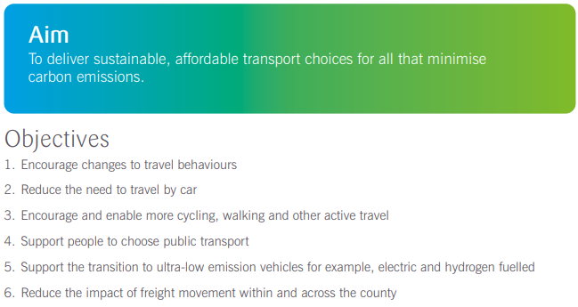
Decarbonising Transport

Slide 20
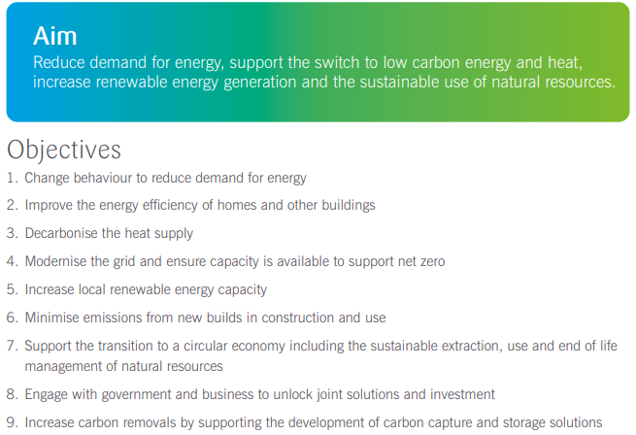
Net Zero Infrastructure

Slide 21
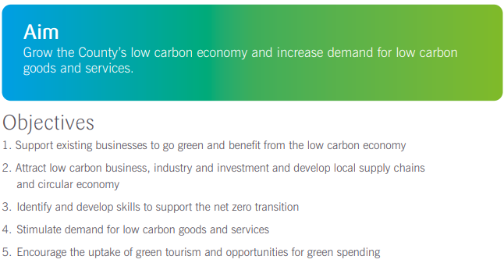
Green Economy

Slide 22
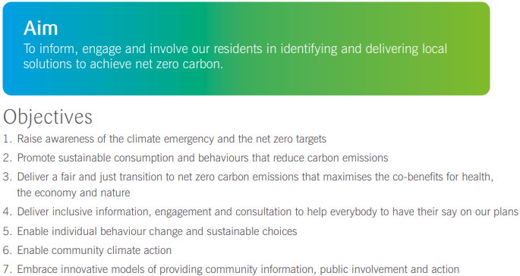
Climate Friendly Communities

Slide 23
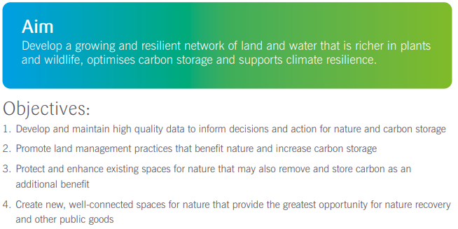
Nature and Land Use

Slide 24
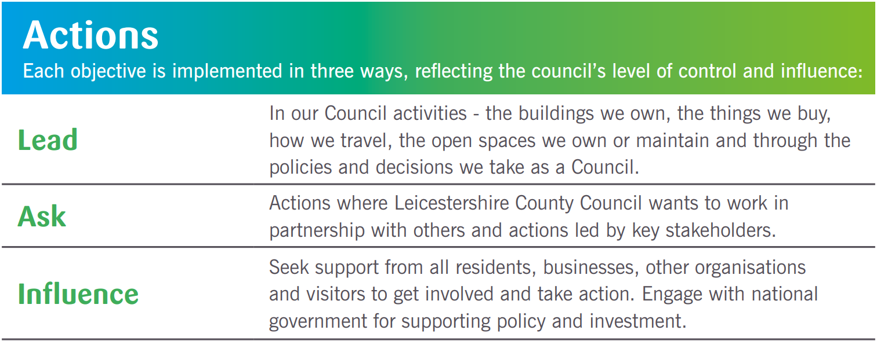
Net Zero Actions
The action plan includes over 150 actions across the five themes
Action Ref | Objective | Action | Partners | Timescale
LEAD – actions where Leicestershire County Council has control or major influence
T1 | All | Continue to work towards Net Zero operations by 2030 by implementing the LCC Carbon Reduction Programme to address the council’s fleet and business travel emissions |  | S
T2 | All | Develop a vision and strategy for decarbonised transport for Leicestershire in the new Local Transport Plan 4 | District councils, Leicester City Council, public transport providers, Midlands Connect | S
ASK – actions where Leicestershire County Council wants to work in partnership and asks of key stakeholders
T3 | 4 | Investigate the council’s role in Accelerating EV Charging Infrastructure | Midlands Connect | S
INFLUENCE – actions where Leicestershire County Council will seek to influence and inspire others
T4 | All | Engage with government for policy and long term funding allocations to support the delivery of capital schemes and promotional activity to decarbonise transport and to clarify its role | ADEPT, Midlands Connect, neighbouring authorities, | S
Example from Transport
Time scale: Short 0-2 years (S), Medium 2-5 years (M), Long >5 years (L)

Slide 25
Net Zero 2045 Strategy and Action Plan Consultation
Objective: To share the Council’s strategy and plans for achieving net zero carbon for Leicestershire and to seek feedback from stakeholders and residents:
Open for 12 weeks 4th May – 26th July 2022.
Offers an opportunity to add to the Strategy and Action Plan, identify synergies with other organisations’ plans and to engage and inspire the public.
Access the full strategy and action plan, alongside the consultation through the Council’s ‘Have Your Say’ webpage here.
We welcome your feedback and input by completing the survey.
Attendance at events and public spaces aims to increase engagement and representation.
Following the consultation, a consultation summary will be produced and feedback fed into the strategy and action plan in Autumn 2022
There will also be ongoing engagement on net zero as reflected in the Climate Friendly Communities theme

Slide 26
The Role of Local Councils

Slide 27
What have we done to date?
A Leicestershire Parish and Town Council Climate Action Day was held on 3rd December 2020 with 35 delegates
This included an introduction to climate science and policy, workshops on community engagement and action planning
Outputs are available at: https://www.leicestershirecommunities.org.uk/cs/climate-action.html including
List of target audiences, key messages and communication channels
A long list of actions that can be taken by Local Councils to tackle climate change
Resources available e.g. CSE Neighbourhood Development Planning support, Midlands Net Zero Hub Carbon Footprint Tool, CSE advice leaflets
Action Plan templates

Slide 28
Examples of actions Local Councils can take
Lead by example
Reduce the need to travel to meetings or ensure active or sustainable travel is encouraged
Manage assets to support climate action – tree planting, biodiversity projects
Communicate
Share best practice
Source/educate/support community champions
Support Community Action
Consider net zero and sustainability in Neighbourhood Plans- promoting active travel, low carbon new builds, Electric Vehicle Charging, Biodiversity Net Gain
Source funding for projects – EV charging, EV car clubs
Reduce energy in council buildings – consider Public Sector Decarbonisation Funding
Include Net Zero or sustainability in community communications
Promote local green businesses/tourism and local produce

Slide 29
What are the barriers to acting on climate change and how can we work together to over come them?
With other 10,000 Local Councils nationally, together we can have a great impact!
Case Study: Leicestershire Urban Verge Wildlife Project
We’d like you to think about…
What are the key actions you can deliver to support a Net Zero Leicestershire?
What are the key barriers to Local Councils taking this action?
How can we work together to overcome them / What support is required?

Slide 30
The Leicestershire Climate and Nature Pact
As part of our engagement on Net Zero, we will be asking strategic partners to review and sign up to a Leicestershire Climate and Nature Pact
Based on the Glasgow Climate Pact, it sets out key principles we must adhere to in order to tackle the climate and ecological emergencies:
Science and Urgency: the need to act on climate change
Mitigation: reducing carbon emissions to net zero
Adaptation: reducing the impacts of climate change
Nature: halting ecological decline and supporting nature recovery
Finance: enabling climate action
Collaboration: working together to deliver greater action
The Pact will be launched with the final version of the Net Zero Carbon Strategy and Action Plan in the Autumn, where the wider business community, organisations and individuals will be invited to sign up and pledge their support too.

Slide 31
Thank you for listening!
Questions?
Michael Suddens
Michael.Suddens@leics.gov.uk
Senior Carbon Reduction Officer
Shaista Farooq
Shaista.Farooq@leics.gov.uk
Carbon Reduction Officer

