Slide 1
Net Zero Leicestershire
Communities Network
Notes:
Average Annual global temperatures 1850 – 2018
Source: University of Reading, Prof Ed Hawkins, #ShowYourStripes

Slide 2
Why Do We Need to Act?
Key Definitions:
Climate change refers to long term (decades or longer) shifts in temperature and weather patterns.
Net zero refers to the point when greenhouse gas emissions being emitted into the atmosphere are balanced with their removal, so there is no overall addition to atmospheric levels.
Locally, extreme weather events are becoming more of an occurrence, such as the record-breaking temperatures of 39 °C recorded in Summer 2022 and increased number of storms being reported causing mass disruption.
The urgent need for action on climate change has been recognised by over 197 countries globally.
The 2015 Paris Agreement signed countries up to work together in limiting global temperature rise to well below 2°C, with the aim of achieving a 1.5°C limit – the recognised level to limit the risks and impacts of climate change.
If net zero is to be achieved we all need to take action; organisations, individuals and businesses, in addition to local and national government.

Slide 3
Leicestershire’s Net Zero Commitments
The County Council declared a climate emergency in 2019.
We plan to achieve net zero for our own operations by 2030, having already reduced emissions by over 70% since 2008-09.
We are also committed to working with others to achieve net zero in Leicestershire by 2045.
To facilitate this, we commissioned research into the county’s baseline emissions, pathways to net zero and developed the Net Zero Leicestershire Strategy and Action Plan.
We held a 12-week consultation open from May to July 2022, where we sought feedback from 1400 stakeholders.
Visit our Net Zero Leicestershire Webpages for more information: https://www.leicestershire.gov.uk/environment-and-planning/net-zero

Slide 4
Net Zero Leicestershire Strategy and Action Plan
Informed by research and evidence, built on best practice and shaped by 1400 stakeholders.
The themes and overall aims are:
Transport: To deliver low-carbon, affordable transport choices for all
Buildings and Energy: To reduce demand for energy, support the switch to low carbon energy and heat, and increase renewable energy generation
Resources and Waste: To support the transition to a circular economy including the sustainable extraction, use and end of life management of natural resources.
Business and Economy: To help businesses to “go green”, grow the County’s low carbon economy and increase demand for low carbon goods and services
Communities: To inform, engage and involve residents and communities in identifying and delivering local solutions to achieve net zero carbon
Nature and Land Use: To develop a growing and resilient network of land and water that is richer in plants and wildlife, optimises carbon storage and supports climate resilience.

Slide 5
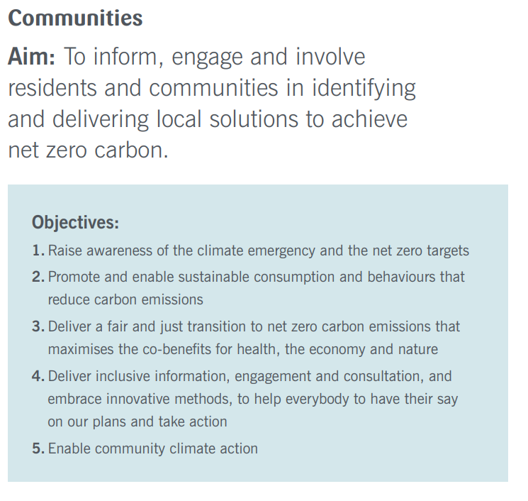
Communities Theme

Slide 6
Net Zero Communities Theme
Engagement
C1 – Develop Leicestershire Climate and Nature Pact
C2 – Develop a public engagement plan to facilitate two-way climate conversation
C3 – Deliver public and stakeholder engagement that is representative and inclusive (just transition)
C4 – Explore options for innovative community governance, i.e. citizens panel/youth co-creation.
C5 – Develop coordinated and integrated communications campaigns to help residents take action
C6 – Explore opportunities to increase training, education and events
C8 – Integrate net zero in to linked consultation and engagement activities
C9 – Develop opportunities to involve young people in shaping climate action & work closely with schools
C11 – Develop tools and guidance to support communities to reduce carbon
Enabling Action
C14/C15 – Explore opportunities for community sector organisations to support net zero
C16 – Enable local councils to act on carbon reduction through information and training
C17 - Share best practice case studies of community action

Slide 7
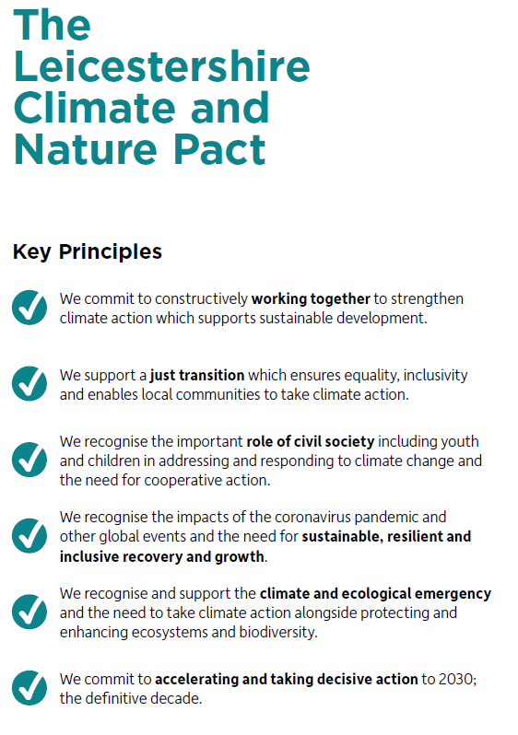
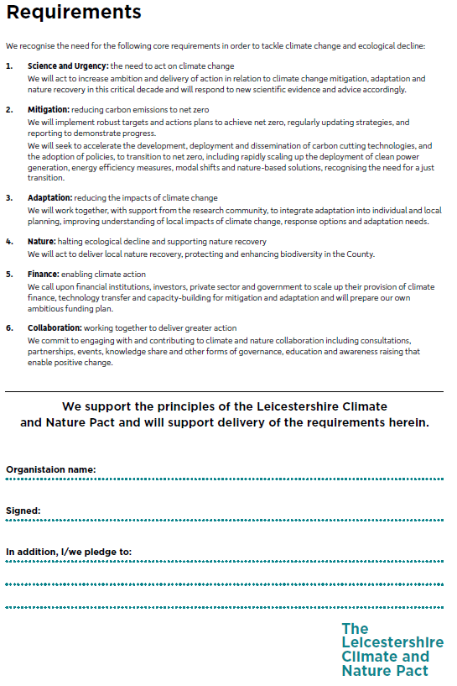
The Leicestershire Climate and Nature Pact

Slide 8
Our Climate and Nature Pact launch partners…
Halstead Hill Farm
Bottesford Net Zero

Slide 9
How Can Communities Make a Difference
Collaboration: Communities working together can make a powerful impact on climate change. By pooling resources and knowledge, they can raise awareness, promote sustainable practices, and advocate for climate-friendly policies.
Local Solutions: Communities have unique insights into their local context and can help identify tailored solutions.
Policy Advocacy: Engaging with local authorities, communities can influence decision-making and advocate for climate-friendly policies. Through constructive dialogue, we can shape policies that support sustainable land use, emission reductions, and climate resilience.
Building Resilience: Communities can prepare for climate change impacts by fostering social cohesion, creating emergency plans, supporting sustainable agriculture, conserving natural resources, and investing in climate-resilient infrastructure.
Notes:
Together, communities can drive positive change, create sustainable solutions, influence policies, and build resilience to combat climate change effectively.

Slide 10
Leicestershire County Council Engagement with Communities
Consultation: Listening to Youth Voices
We heard from over 500 young people during our public consultation on the draft net zero strategy and action plan. Their valuable views on climate change helped shape our initiatives.
Net Zero Campaign
We celebrated the launch of our final Net Zero Strategy and Action Plan with a 6 week campaign including a dedicated week for communities. We promoted initiatives like the community fridge project and park run, and celebrated our Environment Action Volunteers. We also held a creative competition for young people to design posters on reducing carbon footprint.
Net Zero Webpages: Your Knowledge Hub
Our user-friendly net zero webpages provide valuable resources and guidance to residents, businesses, and community groups. Explore the dedicated communities section for advice at www.leicestershire.gov.uk/environment-and-planning/net-zero
Town and Parish Council, and Community Groups toolkit
In collaboration with Districts, we are launching a toolkit soon to help town and parish council and community groups tackle net zero in their communities. With practical tips, advice and examples of good practice, it will act as useful aide for local action.

Slide 11
Get Involved
Talks by Waste Experts: Waste Prevention and Recycling Insights
Our knowledgeable waste colleagues offer engaging talks and workshops on waste prevention, recycling, and composting. Schools and community groups benefit from their expertise and learn practical ways to make a difference. To find our more visit www.lesswaste.org.uk
Volunteer Opportunities: Be a Green Champion
Embrace various volunteering opportunities, such as becoming a country park volunteer, environment action volunteer, or tree warden.
Keep Informed with the Latest Updates and Opportunities
Sign up to Environment Matters to receive the latest news and updates on the environment across Leicestershire.
Sign the Leicestershire Climate and Nature Pact
For further information visit www.leicestershire.gov.uk/environment-and-planning/net-zero

Slide 12
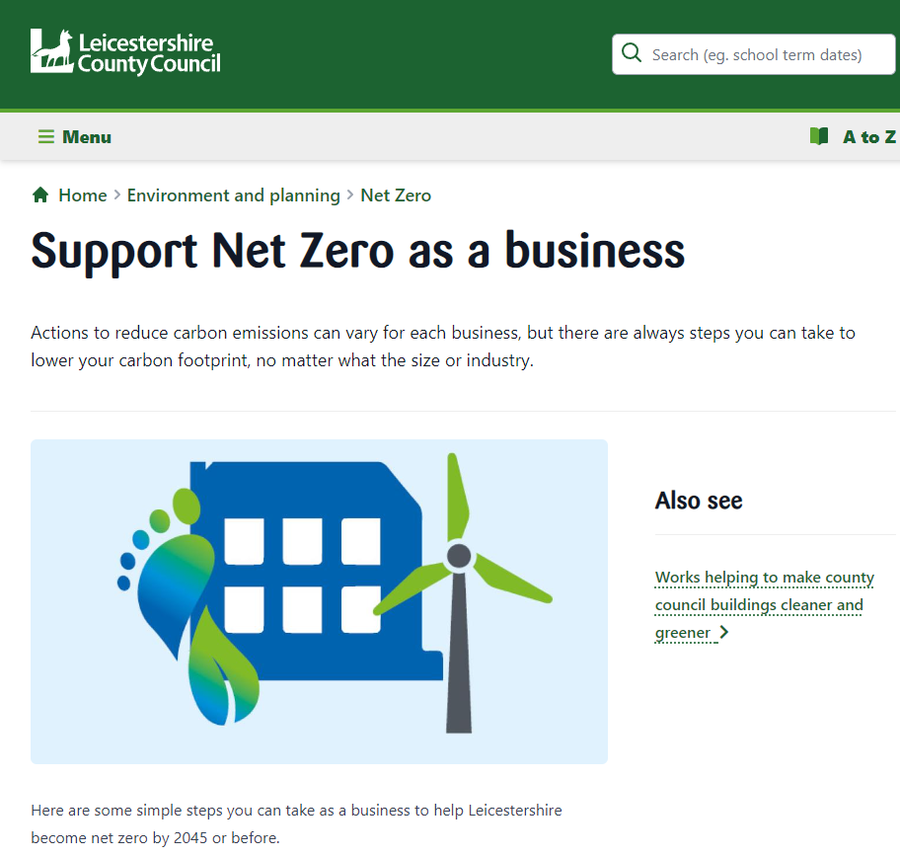
Any Questions?
Thank you for listening!
Michael Suddens
Michael.Suddens@leics.gov.uk
Senior Carbon Reduction Officer
Get in touch with the team directly:
net.zero@leics.gov.uk
Visit our net zero webpages: www.leics.gov.uk/net-zero

