Slide 1
HOUSEHOLD FOOD WASTE
The Waste Initiatives Team | Leicestershire County Council

Slide 2
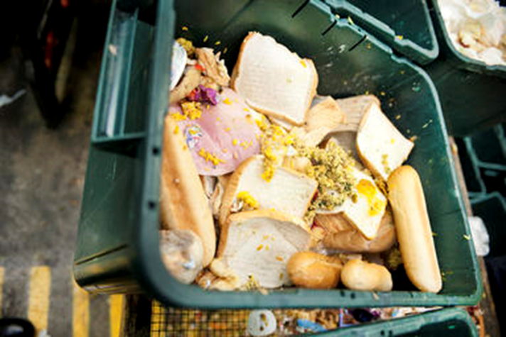
Scale of household food waste
Not used in time
4.5 million tonnes of it is edible/avoidable
Personal preference
6.6 million tonnes of food is thrown away by UK households each year
Prepared, served or cooked too much
Other

Slide 3
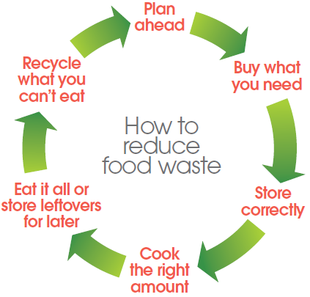
How to reduce food waste

Slide 4
Love Food Hate Waste
WRAP launched Love Food Hate Waste in 2007 to help UK households recognise and tackle food waste
Leicestershire County Council support WRAP’s Love Food Hate Waste campaign, are part of WRAP’s Household Food Waste Working Group and are a signatory of Courtauld 2030
Support Food Waste Action Week in March

Slide 5
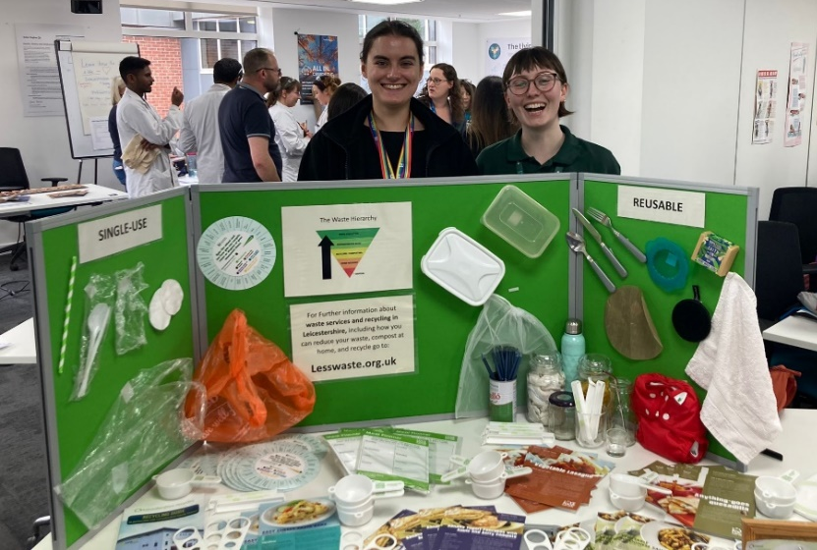
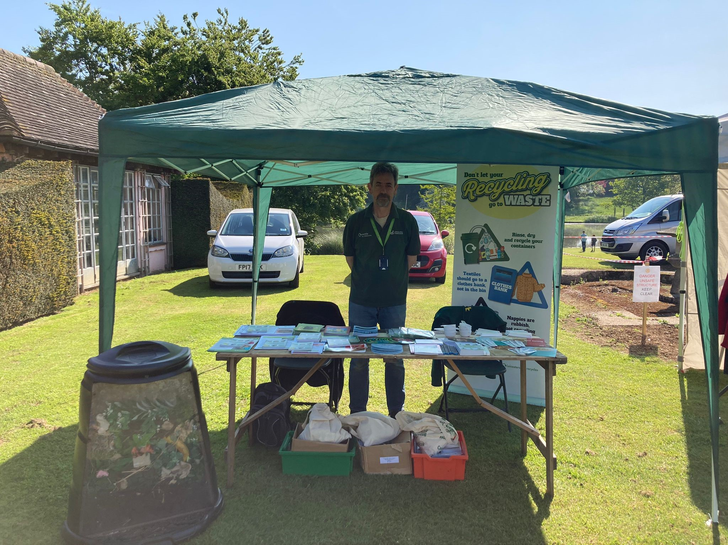
The Waste Initiatives Team
Deliver free talks to schools, community groups and other organisations
Attend events/roadshows throughout the county
Topics we cover are; home composting, food waste, contamination/recycling, reuse and textiles
We also run and manage a volunteer programme called Environment Action Volunteers – visit www.lesswaste.org.uk to find out more
waste.prevention@leics.gov.uk | 0116 305700
www.lesswaste.org.uk

Slide 6
How we spread the message…
Always looking to collaborate with other groups and organisations on food waste prevention projects and campaigns
Work with individuals through Environment Action Volunteers scheme
Seasonal campaigns – Easter, Pancake Day, Chinese New Year, Christmas, Halloween, etc.
Food Waste Action Week – annual national March campaign

Slide 7
Waste Initiatives Team
waste.prevention@leics.gov.uk | 0116 305700
www.lesswaste.org.uk

