Slide 1
Parish Clerks Operational Meeting 22nd June 2023

Slide 2
General update
New Team Manager (Special Projects) Guy Darragh
The Members Highways Fund schemes are progressing. Any specific questions please email me direct.
Parish Pilot – no update this time (volunteers added to the list and will be contacted shortly)
Vegetation post card initiative
Parishes will be contacted next week for next steps.
Asset Sharing Project
Awaiting the mapping link to be available, parishes will be contacted asap
Community Pay Back Scheme – attend a future meeting
Member and Communities E&T Engagement Strategy – full update to the next meeting in August.

Slide 3
Download traffic issues
Traffic chaos was experienced in both directions of the A453 approaching the roundabout with Jnc 24 of the M1 and M1 northbound between Jnc 23 and 24 on Wednesday and Thursday before the event, affecting all road users in that area.
An Event Organisers meeting was held prior to the event attended by NWLDC, National Highways DHL and LCC who set out the traffic plan.
The organisers at Download have apologised for the disruption and will commence a debrief process to understand what went wrong to ensure this is not repeated.
The process will include meeting with local residential and the commercial community at dates to be arranged.
Any complaints or feedback should be directed to the Download contact us function on the Website or by email info@downloadfestival.co.uk however our Network Manager will be attending the debrief meetings so will also feedback any comments provided.

Slide 4
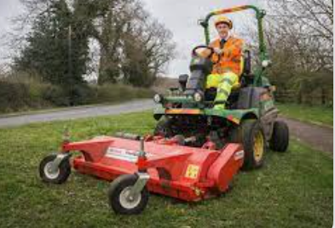
Highways
Grass cutting
2nd urban cut to be completed this week.
2nd rural cut started on 30th May
searchable map and schedule available here
1st Countywide weed spraying treatment started on 12th June programme is available on the LCC website.
Surface Dressing ongoing schedule available here which will be completed by September 2023.
878 highways enquiries were received in June up to now. Most frequent being tree and hedge issues and then potholes.

Slide 5
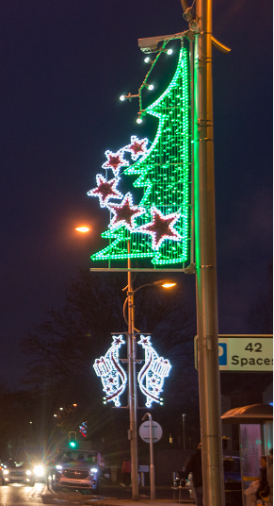
S178 – Christmas lights on lighting columns
A S178 licence is required to install Christmas or Seasonal
lights onto street lighting columns. Guidance and an online
application form can be found on our website. Links below:
Guidance
This covers any apparatus that you may propose to attach to a
street lighting column owned by Leicestershire County Council.
Application form (online)
It important that you read the guidance fully before starting the application process, as there are several mandatory pieces of information required before the system will accept your submission.
Timescales
Applications should aim to be submitted approximately 8 weeks before installation is to take place. Ensure all information is included, as missing information may cause a delay in the application being processed.
A licence is not required for attaching Remembrance day poppies to light columns.

Slide 6
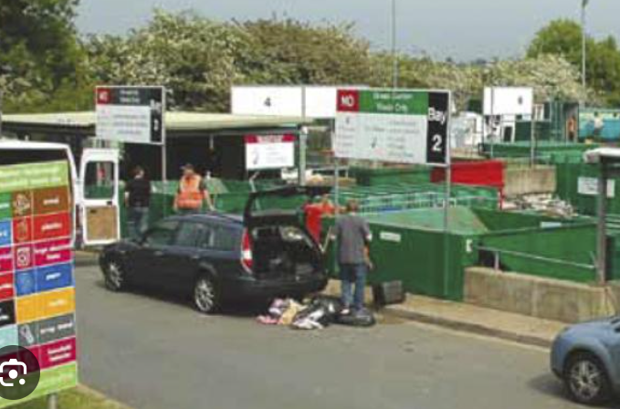
Waste & Environment
Recyling and Household Waste Sites
Along with Loughborough, the site at Whetstone is now a drop off point for community medical aids, which can be recycled/reused.
Please continue to check the website before visiting a waste site due to unplanned closures due to shortage of staff, weather events or incidents.
Staff shortages continue to be an issue at
waste sites but there is a recruitment drive
ongoing for these roles

Slide 7
Strategies
Local Nature Recovery Strategy for Leicestershire, Leicester and Rutland
As the “responsible authority” for the Local Nature Recovery Strategy, enacted in the Environment Act 2021, Leicestershire County Council is holding an online seminar (Fri 30 June 2023, 10:00 till 12:00) on the process of developing the Local Nature Recovery Strategy in Leicestershire, Leicester and Rutland, its purpose and significance. The event is intended for a wide range of stakeholders including landowners, famers, developers, environmental and access groups, universities etc. Information about the event – and the opportunity to book a place – are available on Eventbrite. Booking is essential, though places are free. Any queries should be directed to llrlnrs@leics.gov.uk.
Changes to Local Flood Risk Strategy
Residents are invited to complete on online survey about proposed changes to the 2015 Local Flood Risk Management Strategy as well as being invited to offer comments about any incidents of flooding, affecting personal property or more widely in Leicestershire. Consultation is open Mon 5 June till Sun 13 August 2023.

Slide 8
Any questions ?

