Slide 2
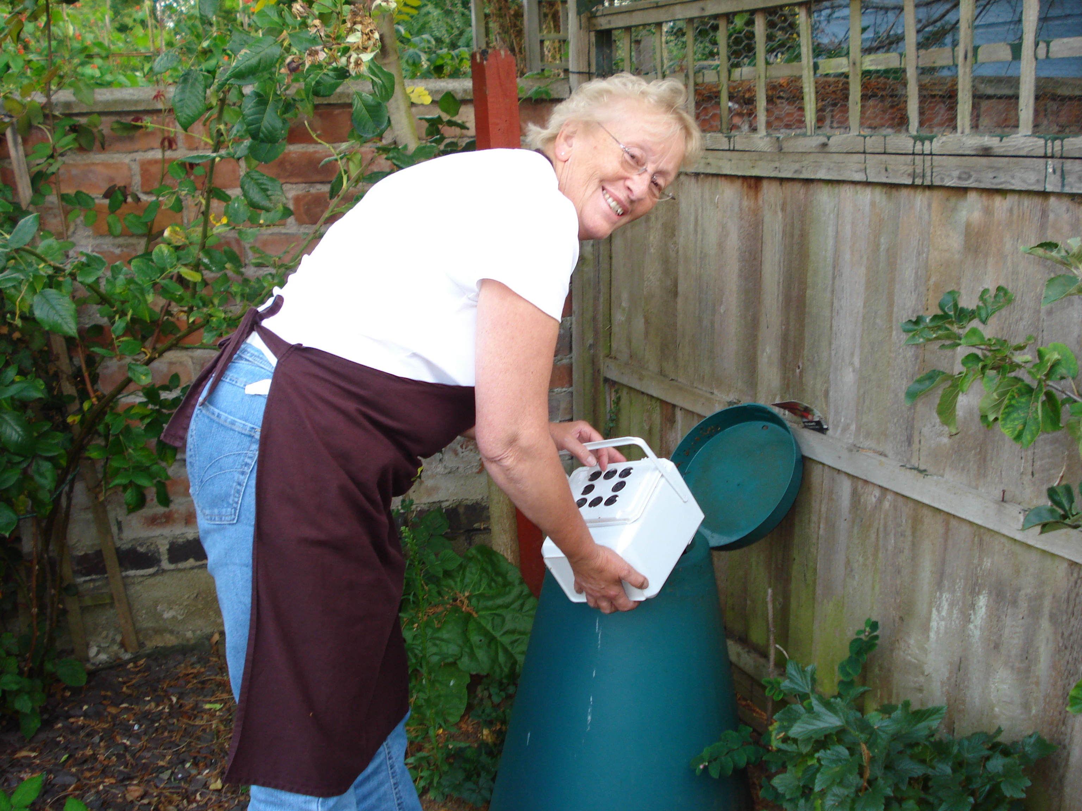
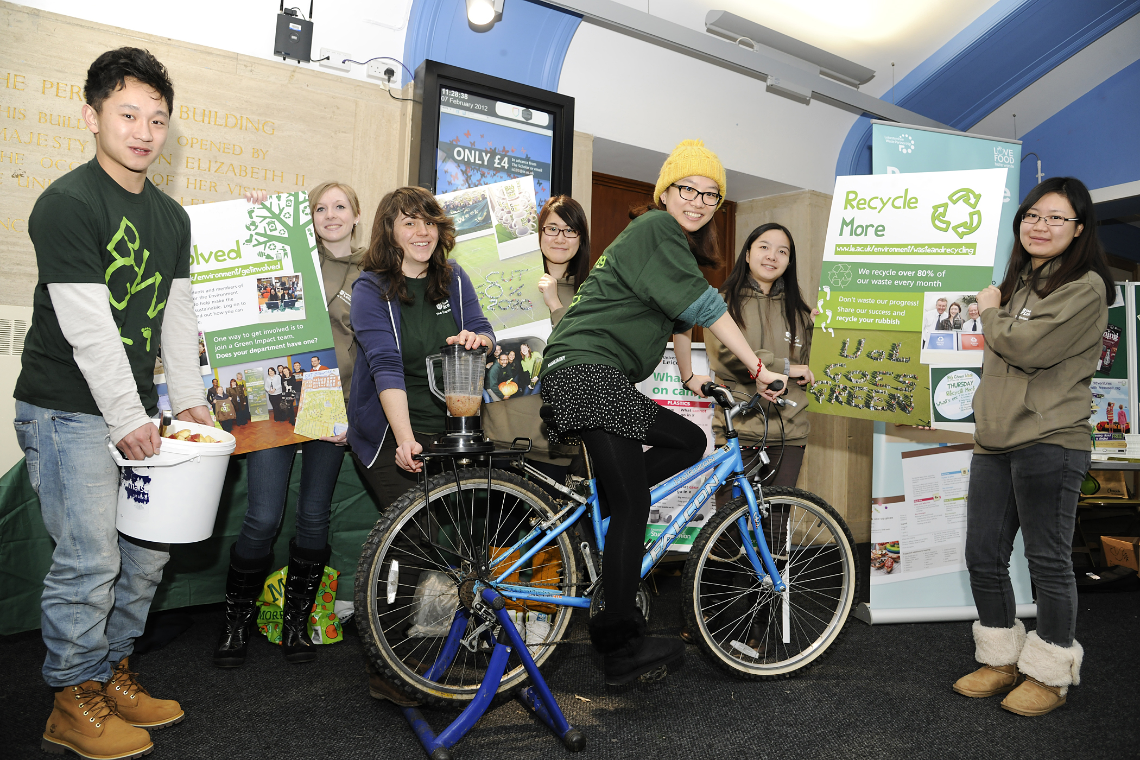
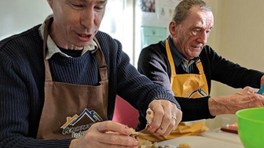
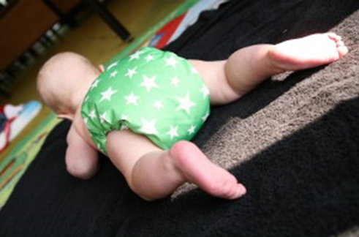
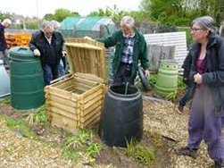
What is an EAV?
An EAV is a volunteer with Leicestershire County Council who helps achieve the councils' strategic aims and makes ‘Leicestershire a better place’.
By:
Driving behavioral change
Be a community hub for information, advice and education
Engaging with residents
Modelling the changes we want to see (pro-social norming)
Networking with other EAV’s

Slide 3
What do EAV’s do?
EAVs work with LCC staff in the Waste and Environment teams to change the behaviour of Leicestershire residents, and or to do specific tasks that help change behaviour.
The way you help to change behaviour depends upon your personal circumstances.
We will provide engagement opportunities, but you will have a large degree of freedom to direct your own activities.
This gives you freedom, but requires a degree of self-motivation

Slide 4
What do other EAV’s do?
Network / build community
Events
Talks
Supporting projects / campaigns
Nappy loans
School visits
Web / social media content
Writing articles in newsletters
Demo sites
Keep us informed & support our agenda

Slide 6
FAQ’s
FAQ’s
How many hours do I have to do?
Being an EAV is great because you can choose how many hours you put in!
Do I need to Drive?
You do not need to be able to drive, you can choose to do activities that are close to where you live, eliminating the need for a car, or you can choose activities such as writing blog posts and articles which can be home based.
How do you support us?
We will support you by providing training and making you aware of opportunities we know about, always get in touch if you need further support though, we are here to help!
How long does the training take?
The training depends on which ‘specialism’ you take, however there is some training all EAV’s do which can take up to a couple of hours to complete.

Slide 7
Please get in contact!
Evie.Small@leics.gov.uk
Evie Small (She/hers)
Environment & Waste Management Technician
Environment & Waste Management
Leicestershire County Council
Room 700, County Hall
Glenfield
LE3 8RJ
0116 3056884

