Slide 1
Children & Family Wellbeing Service
Notes:
All our volunteers receive initial and ongoing training helping to expand your skills and knowledge.
Volunteers need to be over 18
Regular support provided
Mileage paid

Slide 2
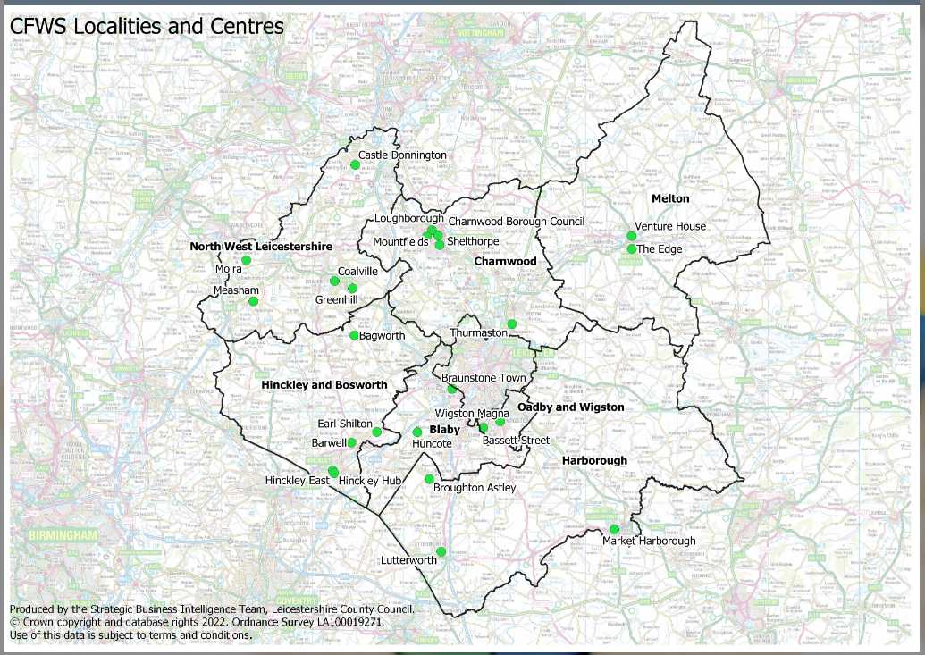
Localities and centres

Slide 3
Volunteer Opportunities
Stay & play group leader
Staff led group support
Community fridge
Youth mentor
Parent support 1-2-1
Appropriate adult
Wellbeing café leaders
Children & Family Wellbeing Service

Slide 4
Scan with your phone camera to visit our website, find out more and apply
Children & Family Wellbeing Service

