Slide 1

Communities Network
Notes:
Good food Leicestershire – is our partnership approach towards a more sustainable food system. The aims and ambitions are set out in our charter. This charter is supported across LCC departments, food and drink businesses and our many community and third sector partners.

Slide 2
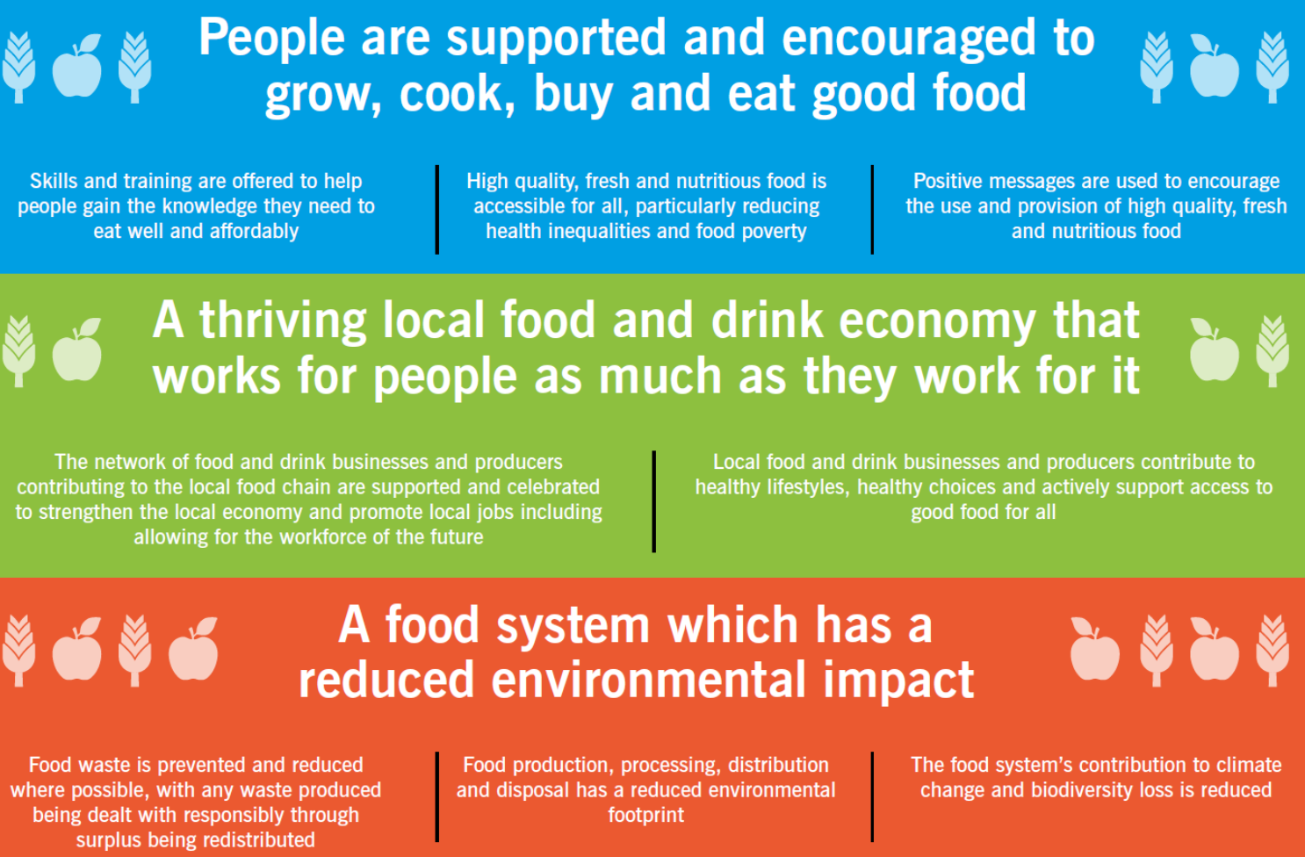
About Good Food Leicestershire
Notes:
The ambitions cut across healthy and accessible food, the food and drink economy including the farmed and rural economy, and the sustainability of food activities e.g. food processing and production and food choices.

Slide 3

National Sustainable Food Places network
Award is for the County not the Council
One of 33 places awarded Bronze since 2015 (9 silver and 2 gold)
Recognises work across all sectors – A place to Grow specifically mentioned
See https://www.sustainablefoodplaces.org/awards/awardwinners/# for Leicestershire’s application

Slide 4
Food poverty

Slide 5
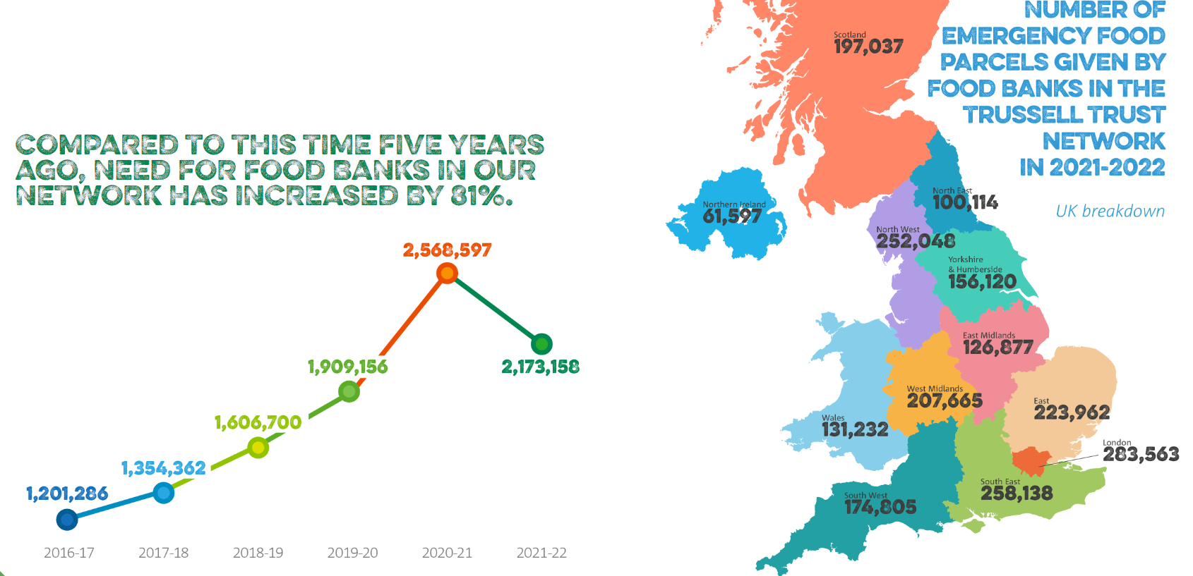
Food poverty - trends

Slide 6
Food poverty – Leicestershire Approach
Rung 1
Fully coordinated across County, Districts and key local agencies. Agreed standards and board, reporting into existing structures e.g. Health and Wellbeing Board.
Rung 2
Combination of coordination and Support - ensuring consistency and provision where needed, supporting local approaches and community projects.
Rung 3
Supported but not necessarily coordinated. Common approaches locally developed and delivered.
Triage -> Support -> referrals
Basic data capture and collaboration
Debt advice
Food Parcels
Triage -> Support -> referrals
Debt advice
Linked community offers e.g cooking/growing courses
Affordable/subsidised groceries
Local food growing
Food sharing app's/advice
Planning and community development (e.g. local provision)
Food surplus/waste e.g. community fridge

Slide 7
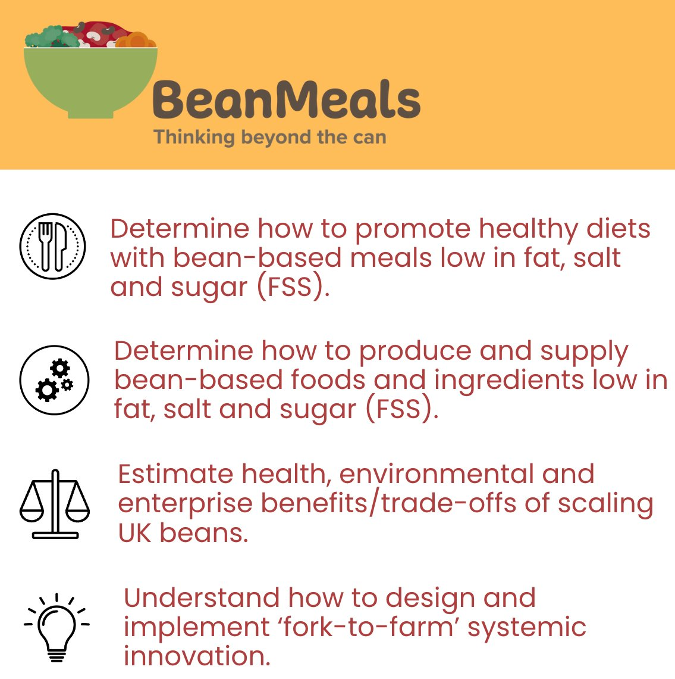

UK Pulses research
Notes:
Initial trial project developed into a large research project led by ECI at Oxford Uni
Many partners including 5 universities, 3Keel, Food for Life and the local community through the food partnerships in Leicester and Leicestershire. School meal pilots in 6 schools across city and county – health benefits, nutritional analysis of beans, new product development including reformulation etc.
Working with local partners across the food chain to understand the appetite for growing beans and linking them into various aspects of the supply chain – and analysis of the economic benefits.

Slide 8
Wider food systems – school food example
Food for Life in schools – Education
Food for Life Served Here – Consumption
Universal nutrition, informed future consumers and partnership approach to driving up social, environmental and economic food outcomes.
Regenerative local supply – Production

Slide 9


Thanks for listening!
Gavin.fletcher@leics.gov.uk
@goodfoodleics

