Slide 1
Welcome to the Communities Network Asset Based Session 22nd November 2023

Slide 2
Today's Session
Quick Team Introductions
Background to the Communities Network – Sabrina Malik
Asset Based Thinking and Doing Session – Sarah Carter
Interactive session and discussion: Networking opportunity & sharing information about local support
Feedback – short online form

Slide 3
What is the Communities Network
Provides a platform form for the communities of Leicestershire to talk to each other about initiatives, projects, and activities, which demonstrate positive action in your local community.
The Network can be used to:
share opportunities to get involved in local projects
make contacts and learn from each other
raise awareness of issues affecting us all and encourage collaboration

Slide 4
Previous Sessions
Cost of Living Support
Volunteering Opportunities
Climate Change inc visits to community allotments
..and anything else that is important to you

Slide 5
Who we work with
Community groups
Voluntary and community sector
Non-parished areas
Businesses
Wider public
Other partner organisations
Young people
Parish and town councils

Slide 6
Useful Links
Sign up to the Communities Network
www.leicestershirecommunities.org.uk/communities-network/
Sign up and receive a quarterly newsletter with event info
www.leicestershirecommunities.org.uk/communities-network/newsletter

Slide 7
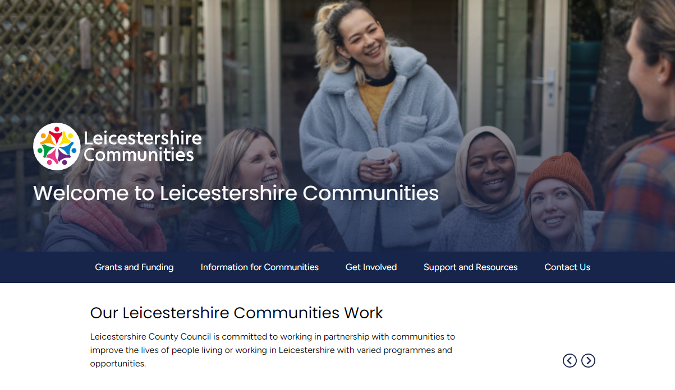
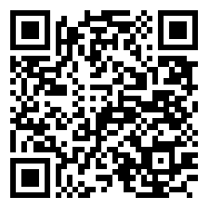
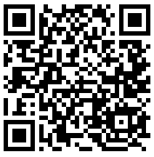
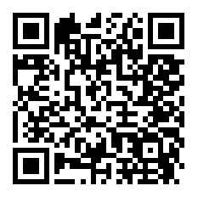
Keep in touch with us!
www.leicestershirecommunities.org.uk
@leicestershirecommunities

