Slide 1
Herbert Daybell
Chair of the Communities Network Foundation (CNF) &
Bottesford Net Zero

Slide 2
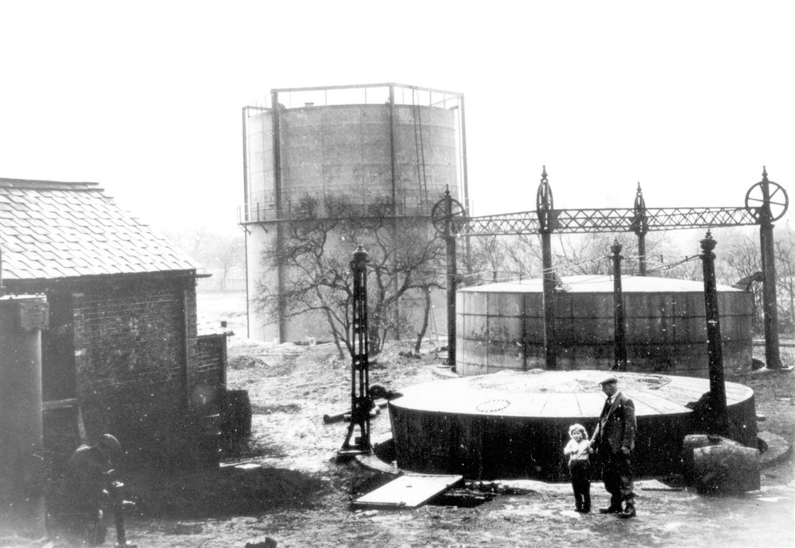
The Village Gas Works

Slide 3
Trees have several valuable uses

Slide 4
Bottesford Tree Charter

Slide 5
Churchyard Community Wildflower Ochard

Slide 6
Compost bins save church £180 a year

Slide 7
Communities Network Foundation

Slide 8
Old school a solar panel and EV site?

Slide 9
Herbert Daybell
Chair of the Communities Network Foundation (CNF) &
Bottesford Net Zero
bottesfordnetzero@gmail.com
www.cnf.org.uk

