Slide 1

Asset (Strength)Based Approaches
An Introduction
Sarah Carter – Communities Business Partner

Slide 2
What’s the plan?
Asset based thinking - it’s all about you!
Assets and asset based approaches – the background info!
Asset based doing – what can we achieve?
Asset based doing – how can we do this?

Slide 3
Asset Based Thinking
It's all About you!
Your name, what you like to be known as
Where you come from
Something you think you are good at or you like doing

Slide 4

What do you see?
What did that have to do with anything?
https://www.youtube.com/watch?v=9UQ5mjFzHTA

Slide 5
Assets and Asset Based Approaches
The terms ‘strengths’ and ‘assets’ are often used interchangeably to apply to either individuals or communities. This guide uses ‘strengths and asset-based approaches’ in relation to both individuals and communities.
Personal strengths and assets:
relationships
experience
skills
aspirations.
Community strengths and assets:
knowledge
people
spaces
networks
services.

Slide 6
Assets and Asset Based Approaches?
“local assets – the skills, knowledge, connections and potential that exists within a community…..the strengths that exist in people and places (Personal, Social, Community, Neighbourhood).)”
(Leicestershire Communities Strategy 2017-21)

Slide 7
What is an Asset Based Approach?
Deficit Focused Approaches
Start with deficiencies and needs in the community
Respond to problems
Provide services to users
Emphasise the role of agencies
Focus on individuals
See people as clients and consumers receiving services
Treat people as passive and done-to
Fix people
Implement Programmes as the answer
Asset Based Approaches
Start with the assets in the community
Identify opportunities and strengths
Invest in people as citizens
Emphasise the role of civil society
Focus on communities and the common good
See people as citizens and co-producers with something to offer
Help people take control of their lives
Support people to develop their potential
See people as the answer

Slide 8

What Are Our Assets?

Slide 9
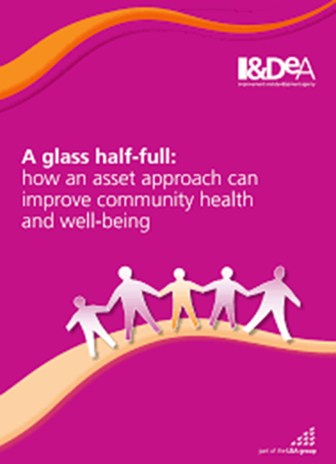
What is an Asset Based
Approach cont…?
“Asset-Based Thinking is not blind optimism or magical thinking. It does not offer the quick fix or over-promise results. It’s not based on theory alone…
Asset-Based Thinking takes “positive thinking” to a whole new level of engagement. While positive thinking calls for a positive attitude about life and the future, Asset-Based Thinking calls for positive action and traction in the present moment……
Action is the key word! Ideas bestowed with ‘positive attitude’ remain just ideas. However, if you take an idea and add ‘positive action and traction’ to it, it becomes innovation.”
source: https://idea-sandbox.com/blog/asset-based-thinking/#ixzz7BfHmyWeh
source: https://idea-sandbox.com/blog/asset-based-thinking/#ixzz7BfHhEljC
source: https://idea-sandbox.com/blog/asset-based-thinking/#ixzz7BfHTPUVT

Slide 10
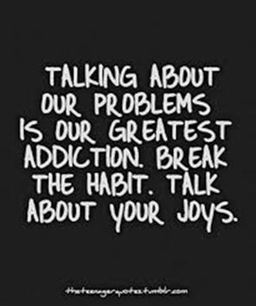
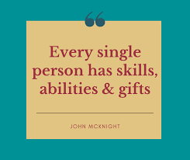

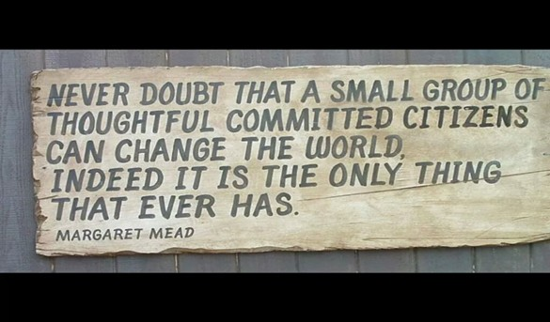
Asset Based Doing
Step 1
“REFRAMING”
Asset Based Conversations
Spend time making sense or exploring the goal with the people you’re working with?
Can you go about achieving the goal another way?
Step 2
“IDENTIFYING ASSETS”
Community Asset Mapping
Have you thought about what ‘assets’ you have and what assets are needed?
Step 3
“MOBILISING”
Connecting Assets
Have you created a space for people to come together, to share individual and group assets?
Step 4
“CO-PRODUCTION”
Working Together for Positive Action
Have you focussed on the main outcome you want to achieve?
Have you remained flexible to change the way you reach your end goal as you work with the assets available to you at the time?

Slide 11
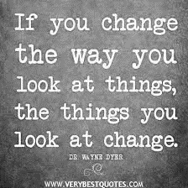
Asset based doing
What Can We Achieve?
Something you would like to achieve in your group/community etc.
could be a change/do differently/achieve without making any extra work? Goals/ objectives/ ambitions?

Slide 12

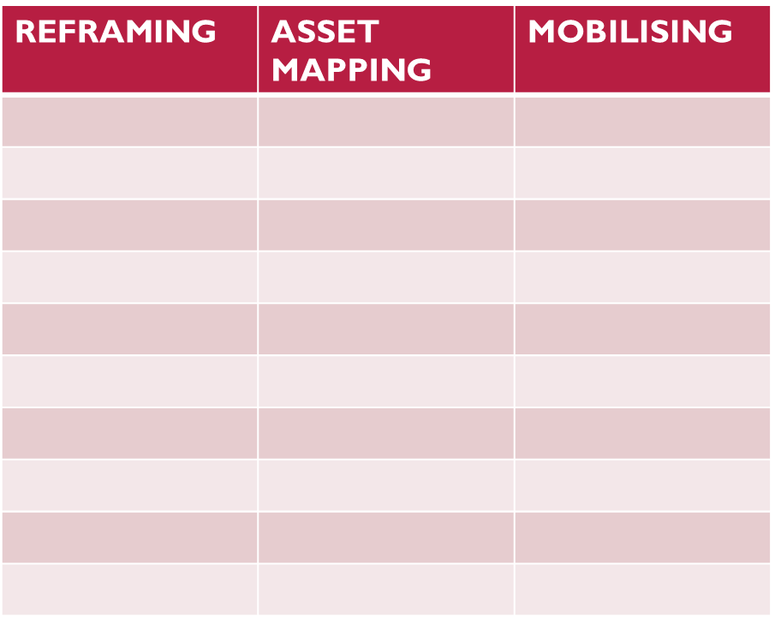
Asset based doing
What Can We Achieve
A Live Example!

Slide 13
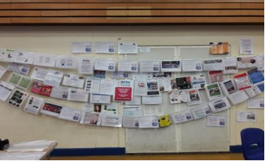
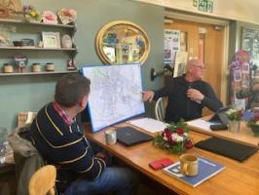
Examples
Ashby washing line!
Melton Foundation Communities Network

Slide 14
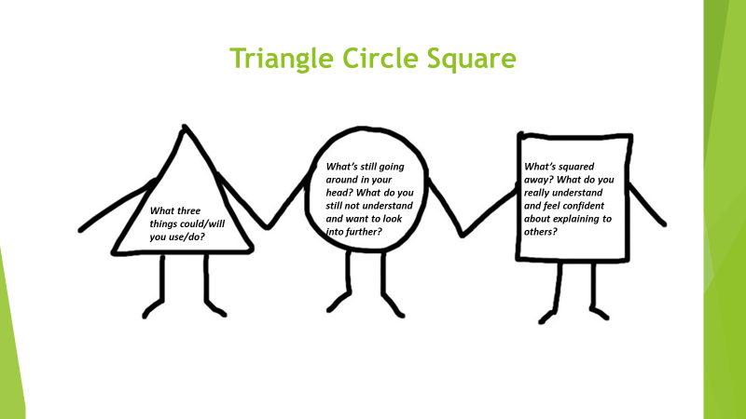
To think about!

Slide 15

THANK YOU

